Slide 1
AGC

Slide 2
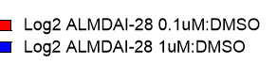
Atypical

Slide 3
CAMK

Slide 4
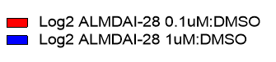
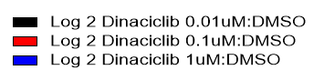
CK1

Slide 5
CMGC

Slide 6
Metabolic

Slide 7
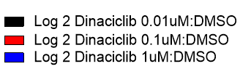
NEK

Slide 8
Other

Slide 9
STE

Slide 10
TK

Slide 11
TKL

Slide 12
Subset 1

Slide 13
